Slide 1

Hyperparameter tuning
Tuning process
deeplearning.ai

Slide 2
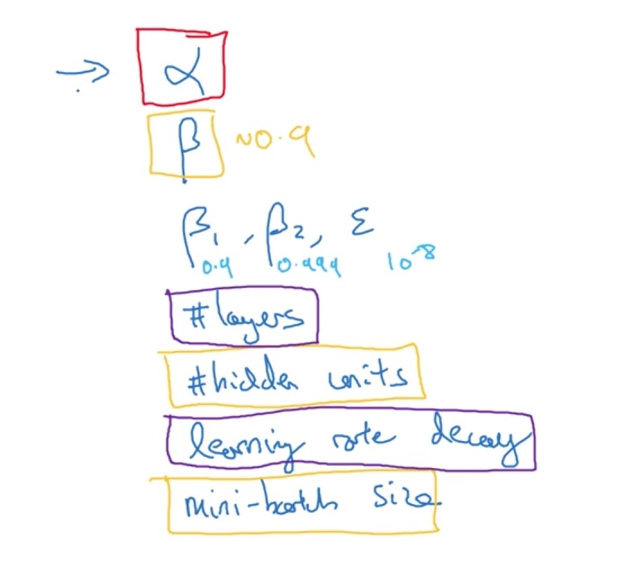
Hyperparameters
Level 1 - Red
Level 2 - Yellow
Level 3 – Purple

Slide 3
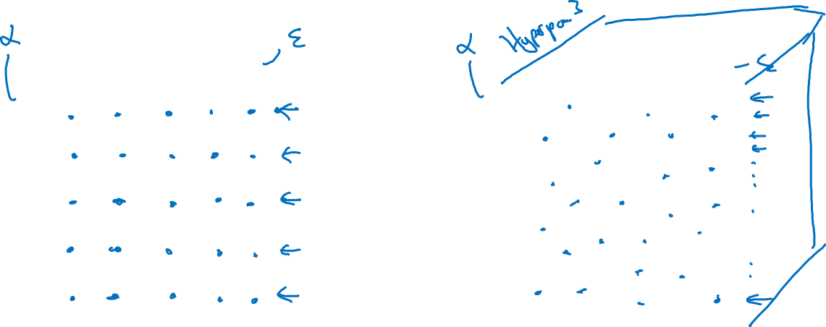
Try random values: Don’t use a grid
Hyperparameter 2
Hyperparameter 2
Hyperparameter 1
Hyperparameter 1

Slide 4
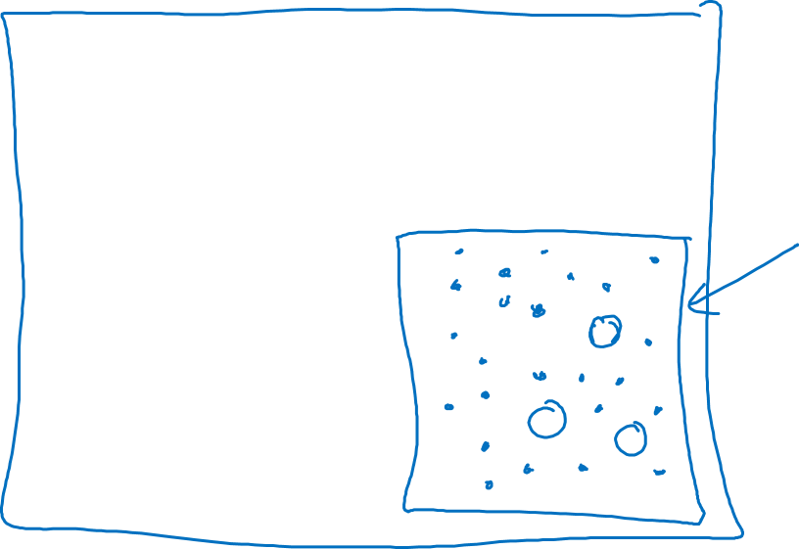
Coarse to fine
Hyperparameter 2
Hyperparameter 1

Slide 5
Hyperparameter tuning
Using an appropriate scale to pick hyperparameters
deeplearning.ai

Slide 6
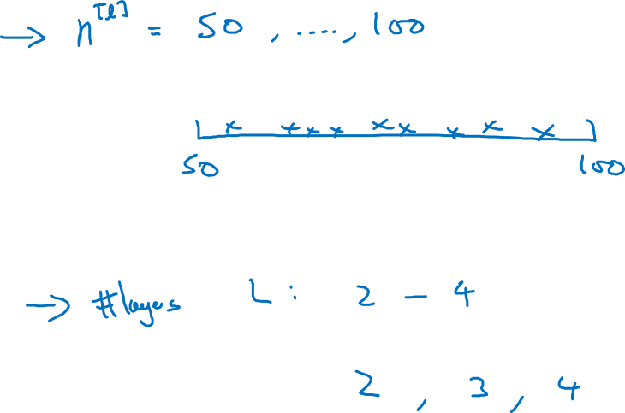
Picking hyperparameters at random

Slide 7
Appropriate scale for hyperparameters

Slide 8
Hyperparameters for exponentially weighted averages

Slide 9
Hyperparameters tuning
Hyperparameters
tuning in practice:
Pandas vs. Caviar
deeplearning.ai

Slide 10

Re-test hyperparameters occasionally
Idea
NLP, Vision, Speech,
Ads, logistics, ….
Intuitions do get stale. Re-evaluate occasionally.
Experiment
Code

Slide 11
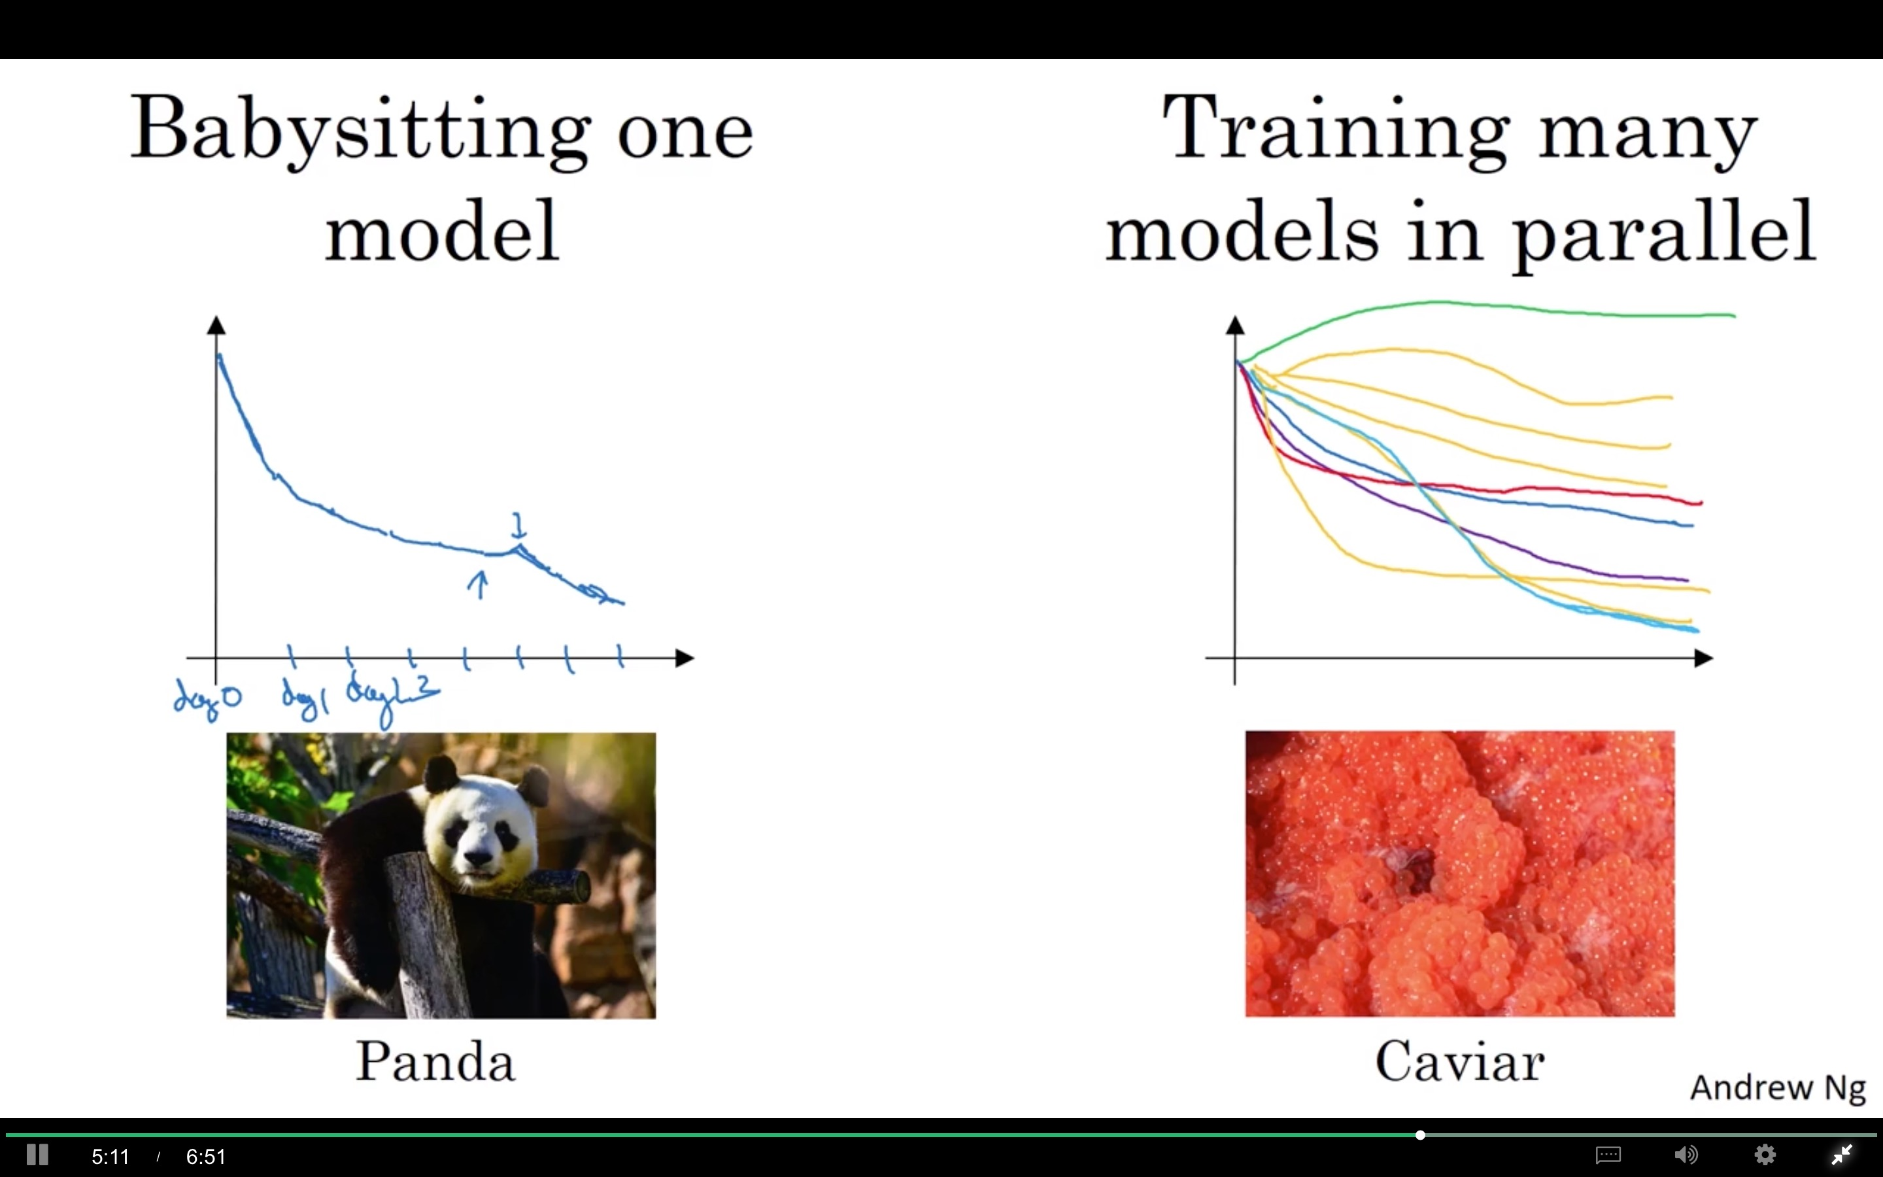

Slide 12
Batch Normalization
Normalizing activations
in a network
deeplearning.ai

Slide 13
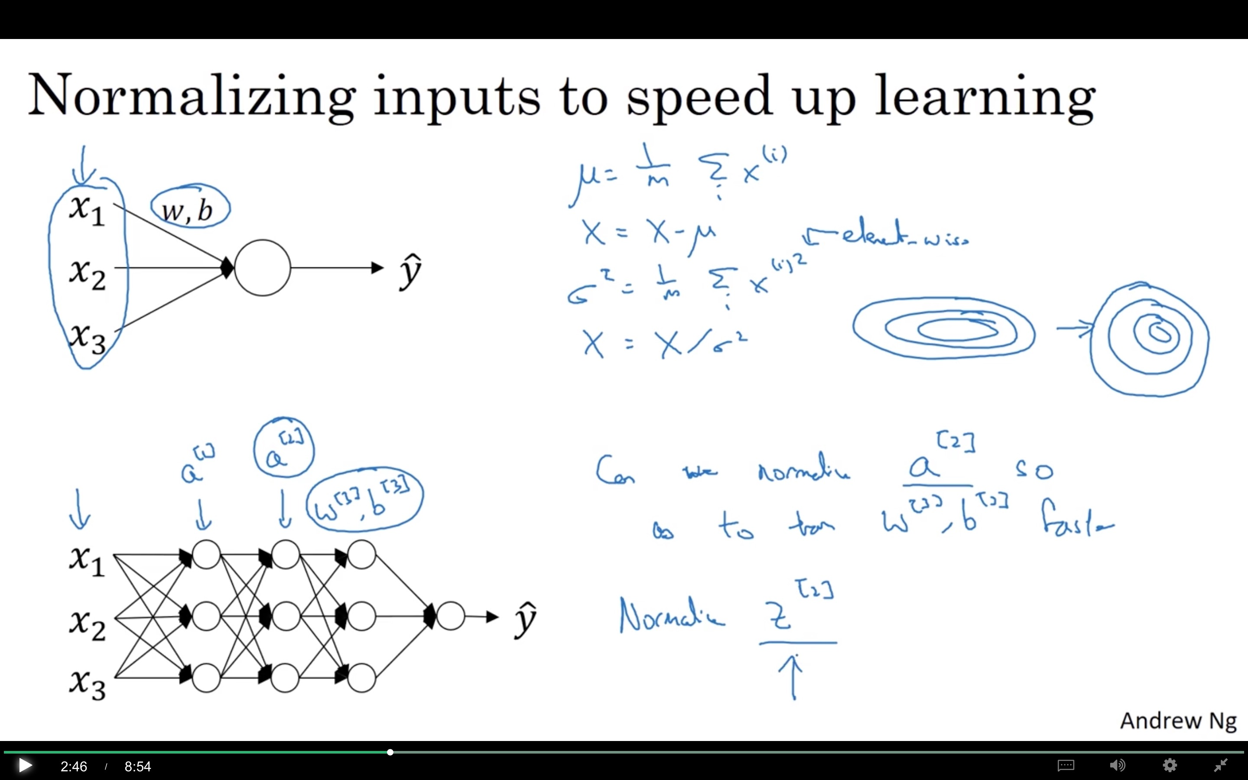

Slide 14
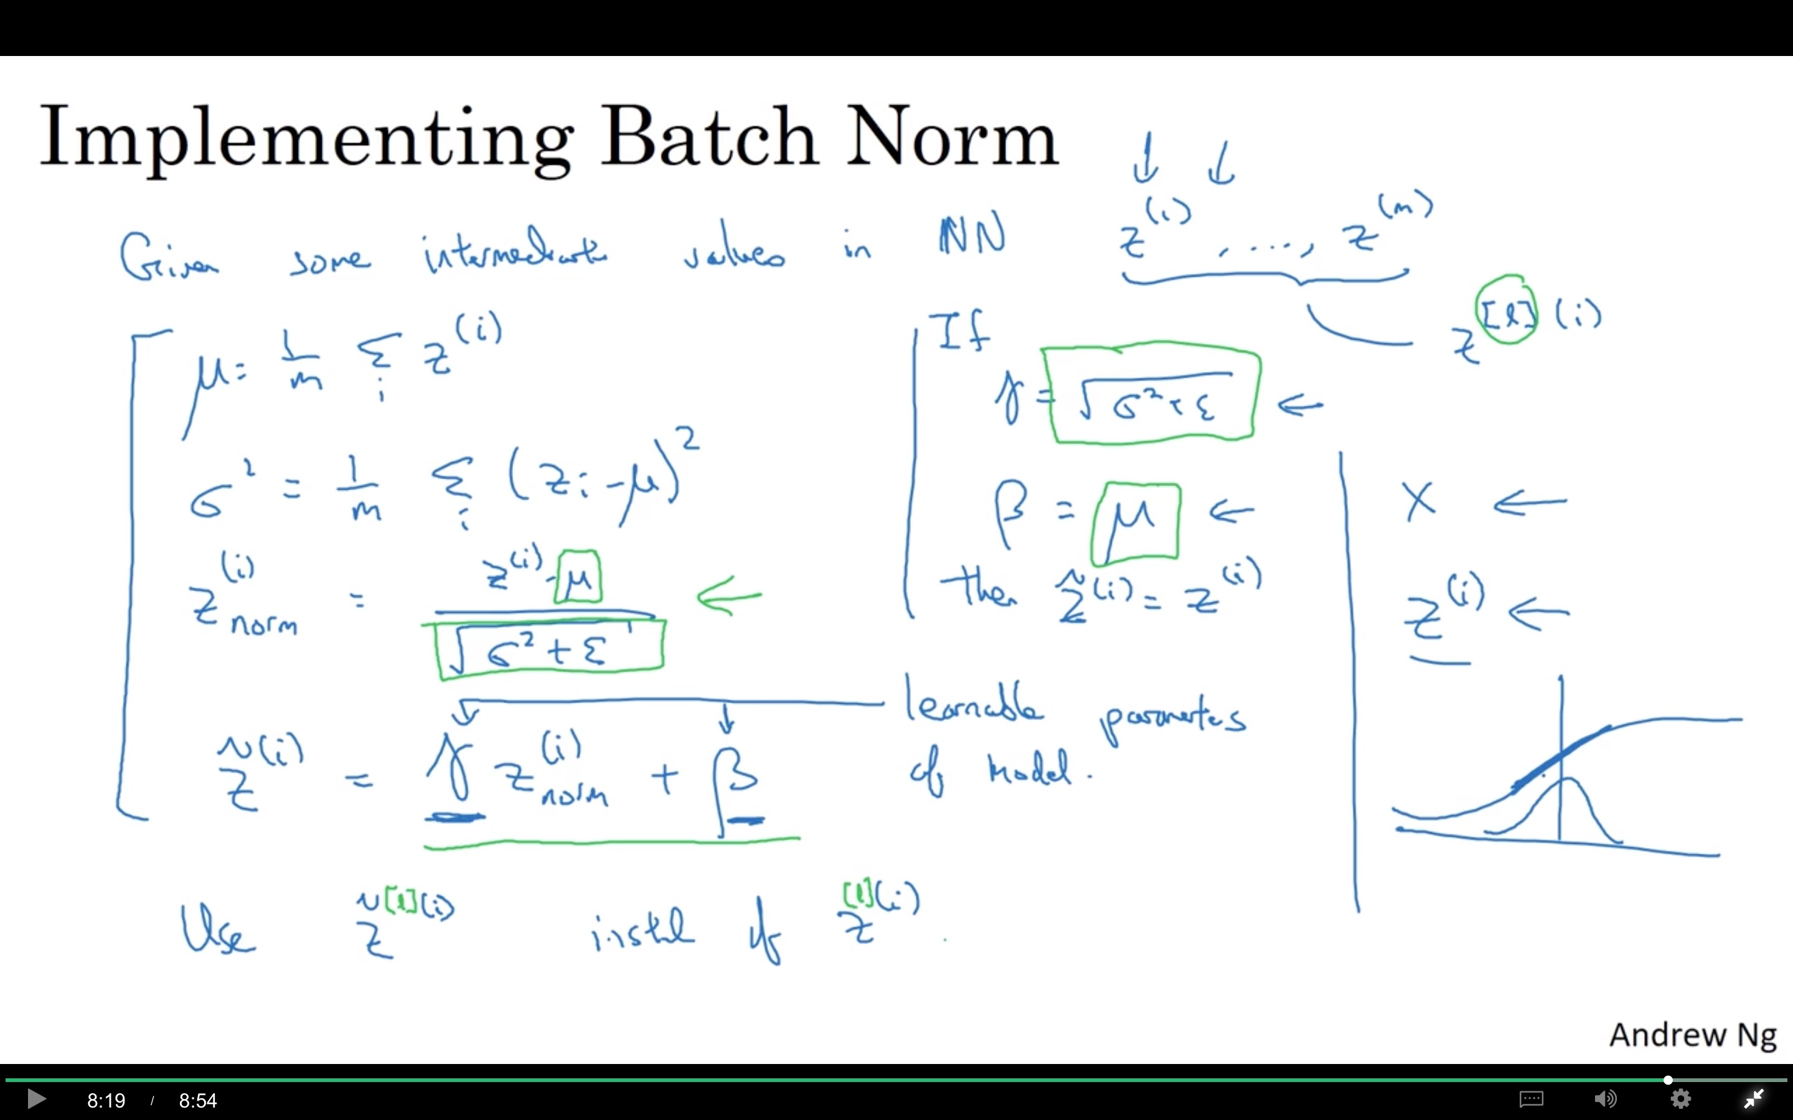

Slide 15
Batch Normalization
Fitting Batch Norm
into a neural network
deeplearning.ai

Slide 16
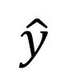
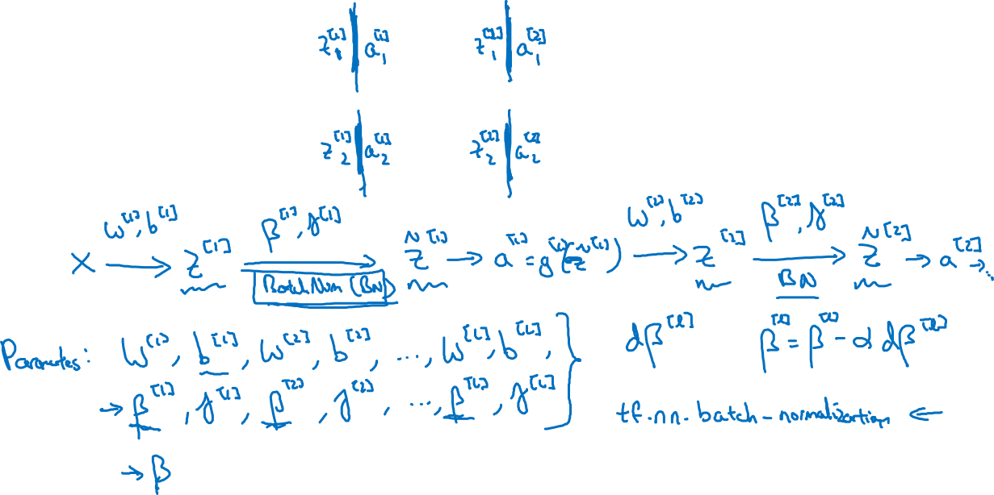
Adding Batch Norm to a network
$$x_{1}$$
$$x_{2}$$
$$\hat{y}$$
$$x_{3}$$

Slide 17
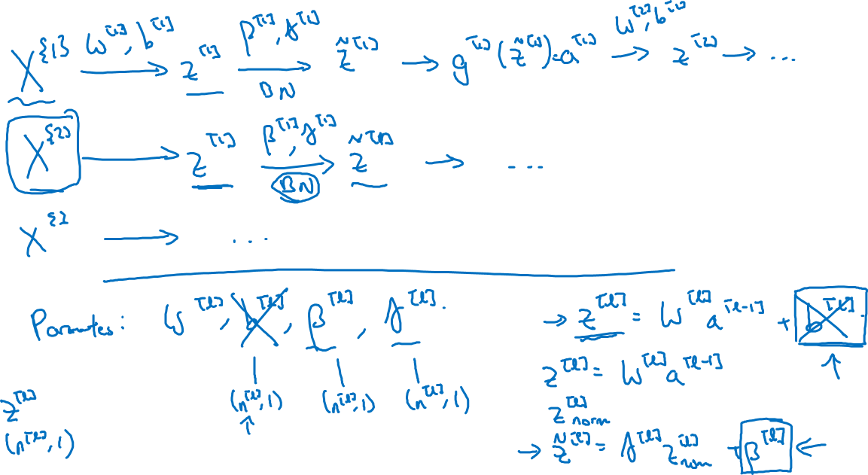
Working with mini-batches

Slide 18
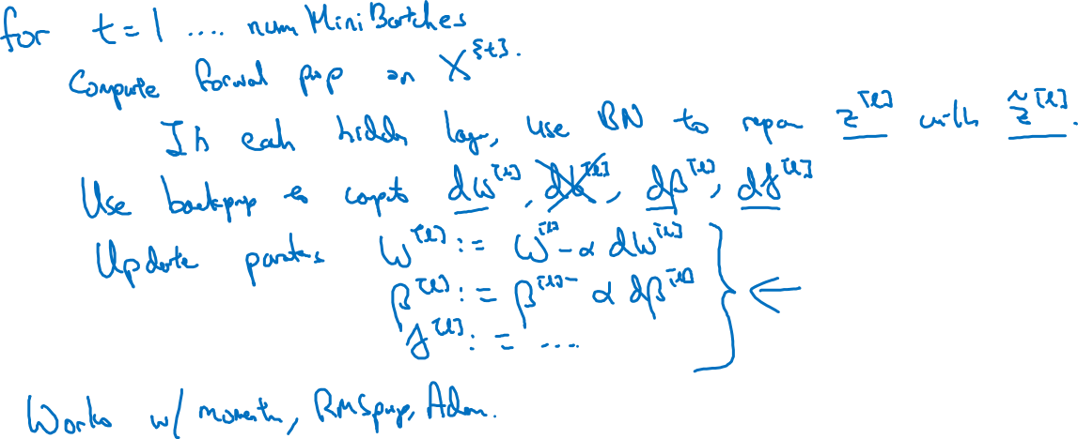
Implementing gradient descent
Question
Backpropagation, need restore Z?
Why use same learning rate for beta and gamma? X (0-255) and Z (relevantly small number)are very different

Slide 19
Batch Normalization
Why does
Batch Norm work?
deeplearning.ai

Slide 20
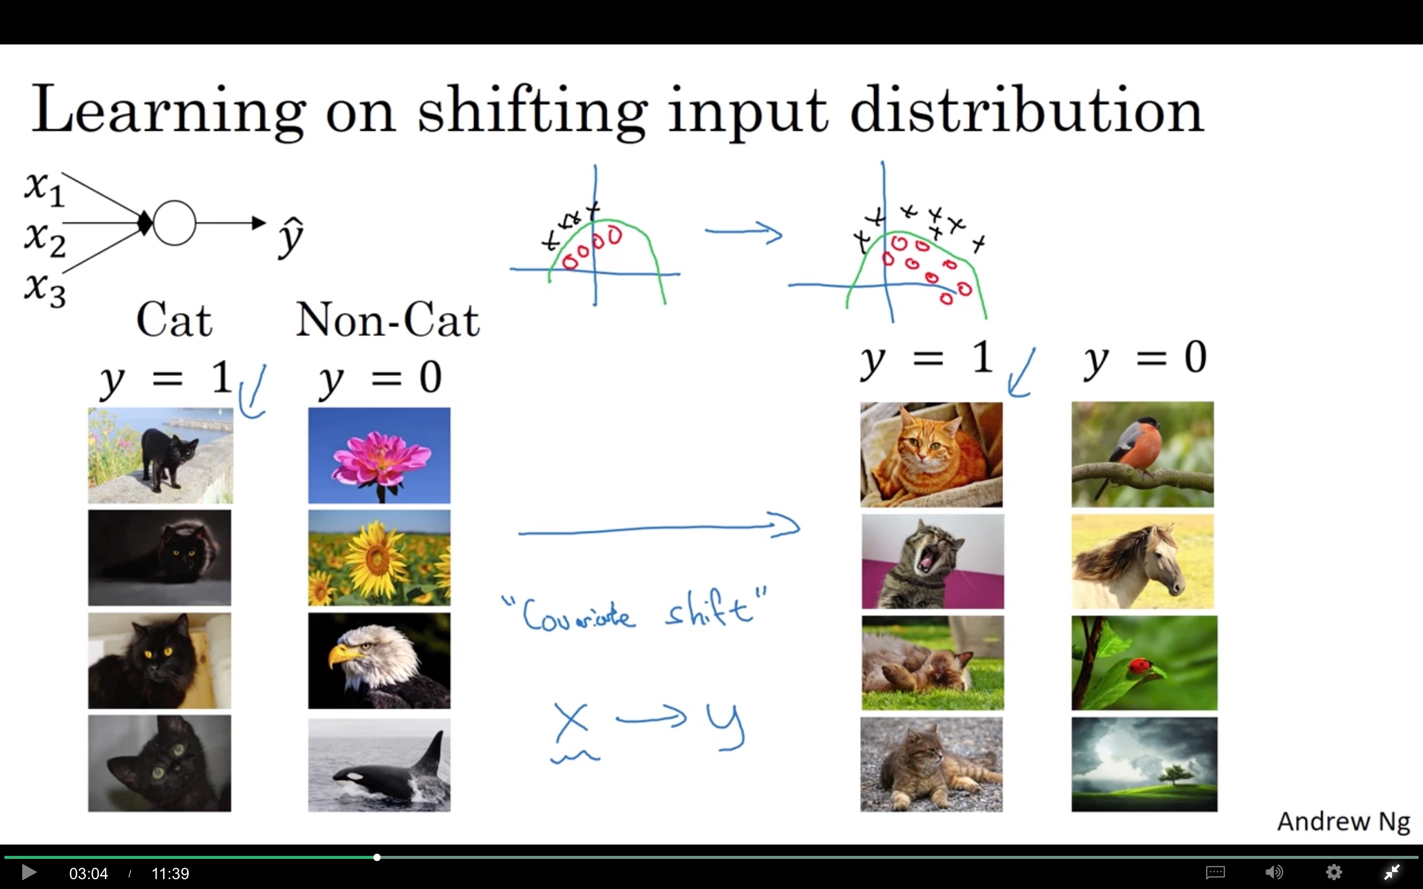

Slide 21
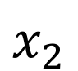
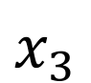
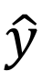
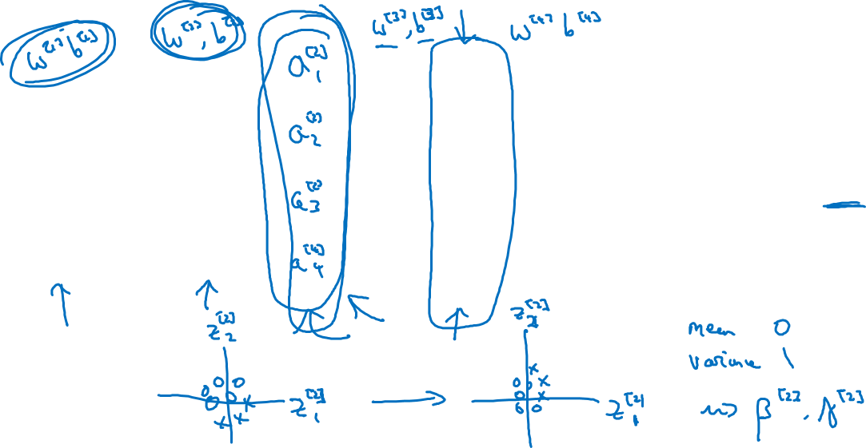
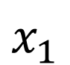
Why this is a problem with neural networks?
$$x_{1}$$
$$x_{2}$$
$$\hat{y}$$
$$x_{3}$$

Slide 22
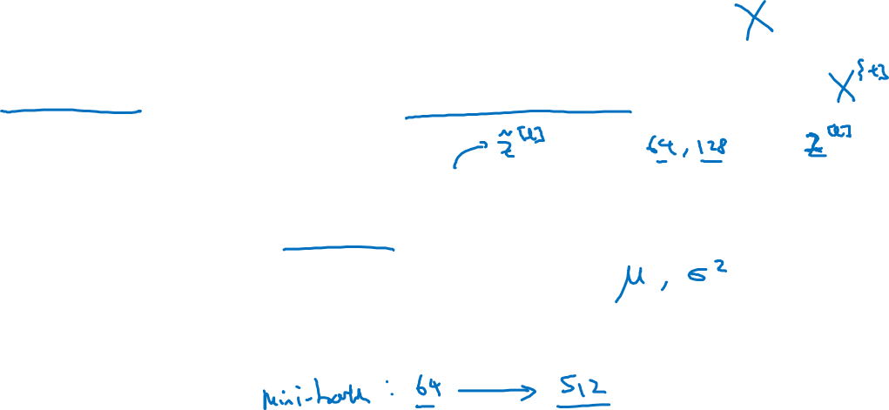
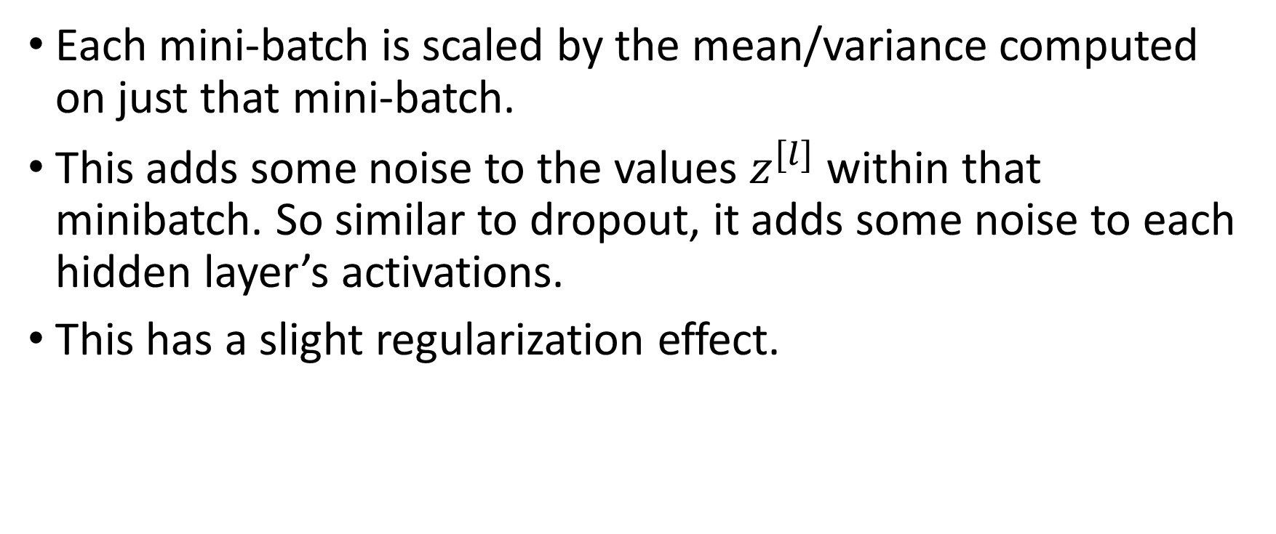
Batch Norm as regularization
Each mini-batch is scaled by the mean/variance computed on just that mini-batch.
This adds some noise to the values $z^{[l]}$ within that minibatch. So similar to dropout, it adds some noise to each hidden layer’s activations.
This has a slight regularization effect.

Slide 23
Batch Normalization
Batch Norm at
test time
deeplearning.ai

Slide 24
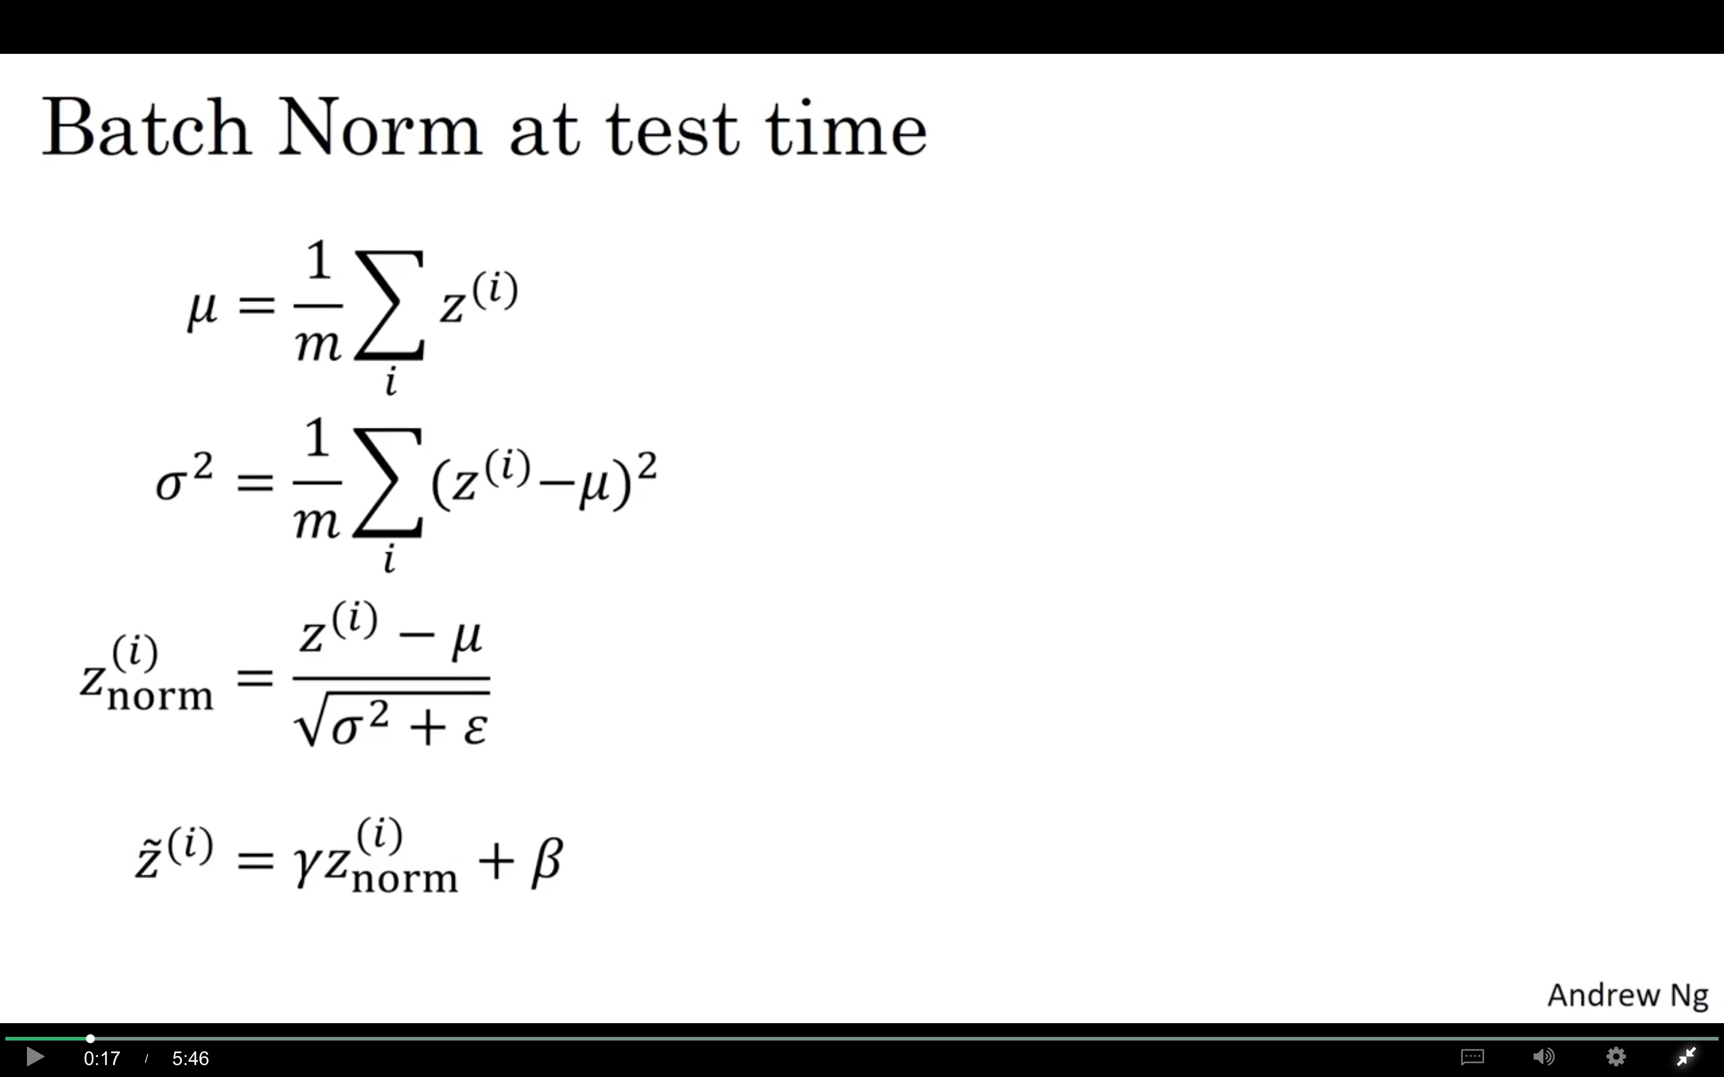

Slide 25
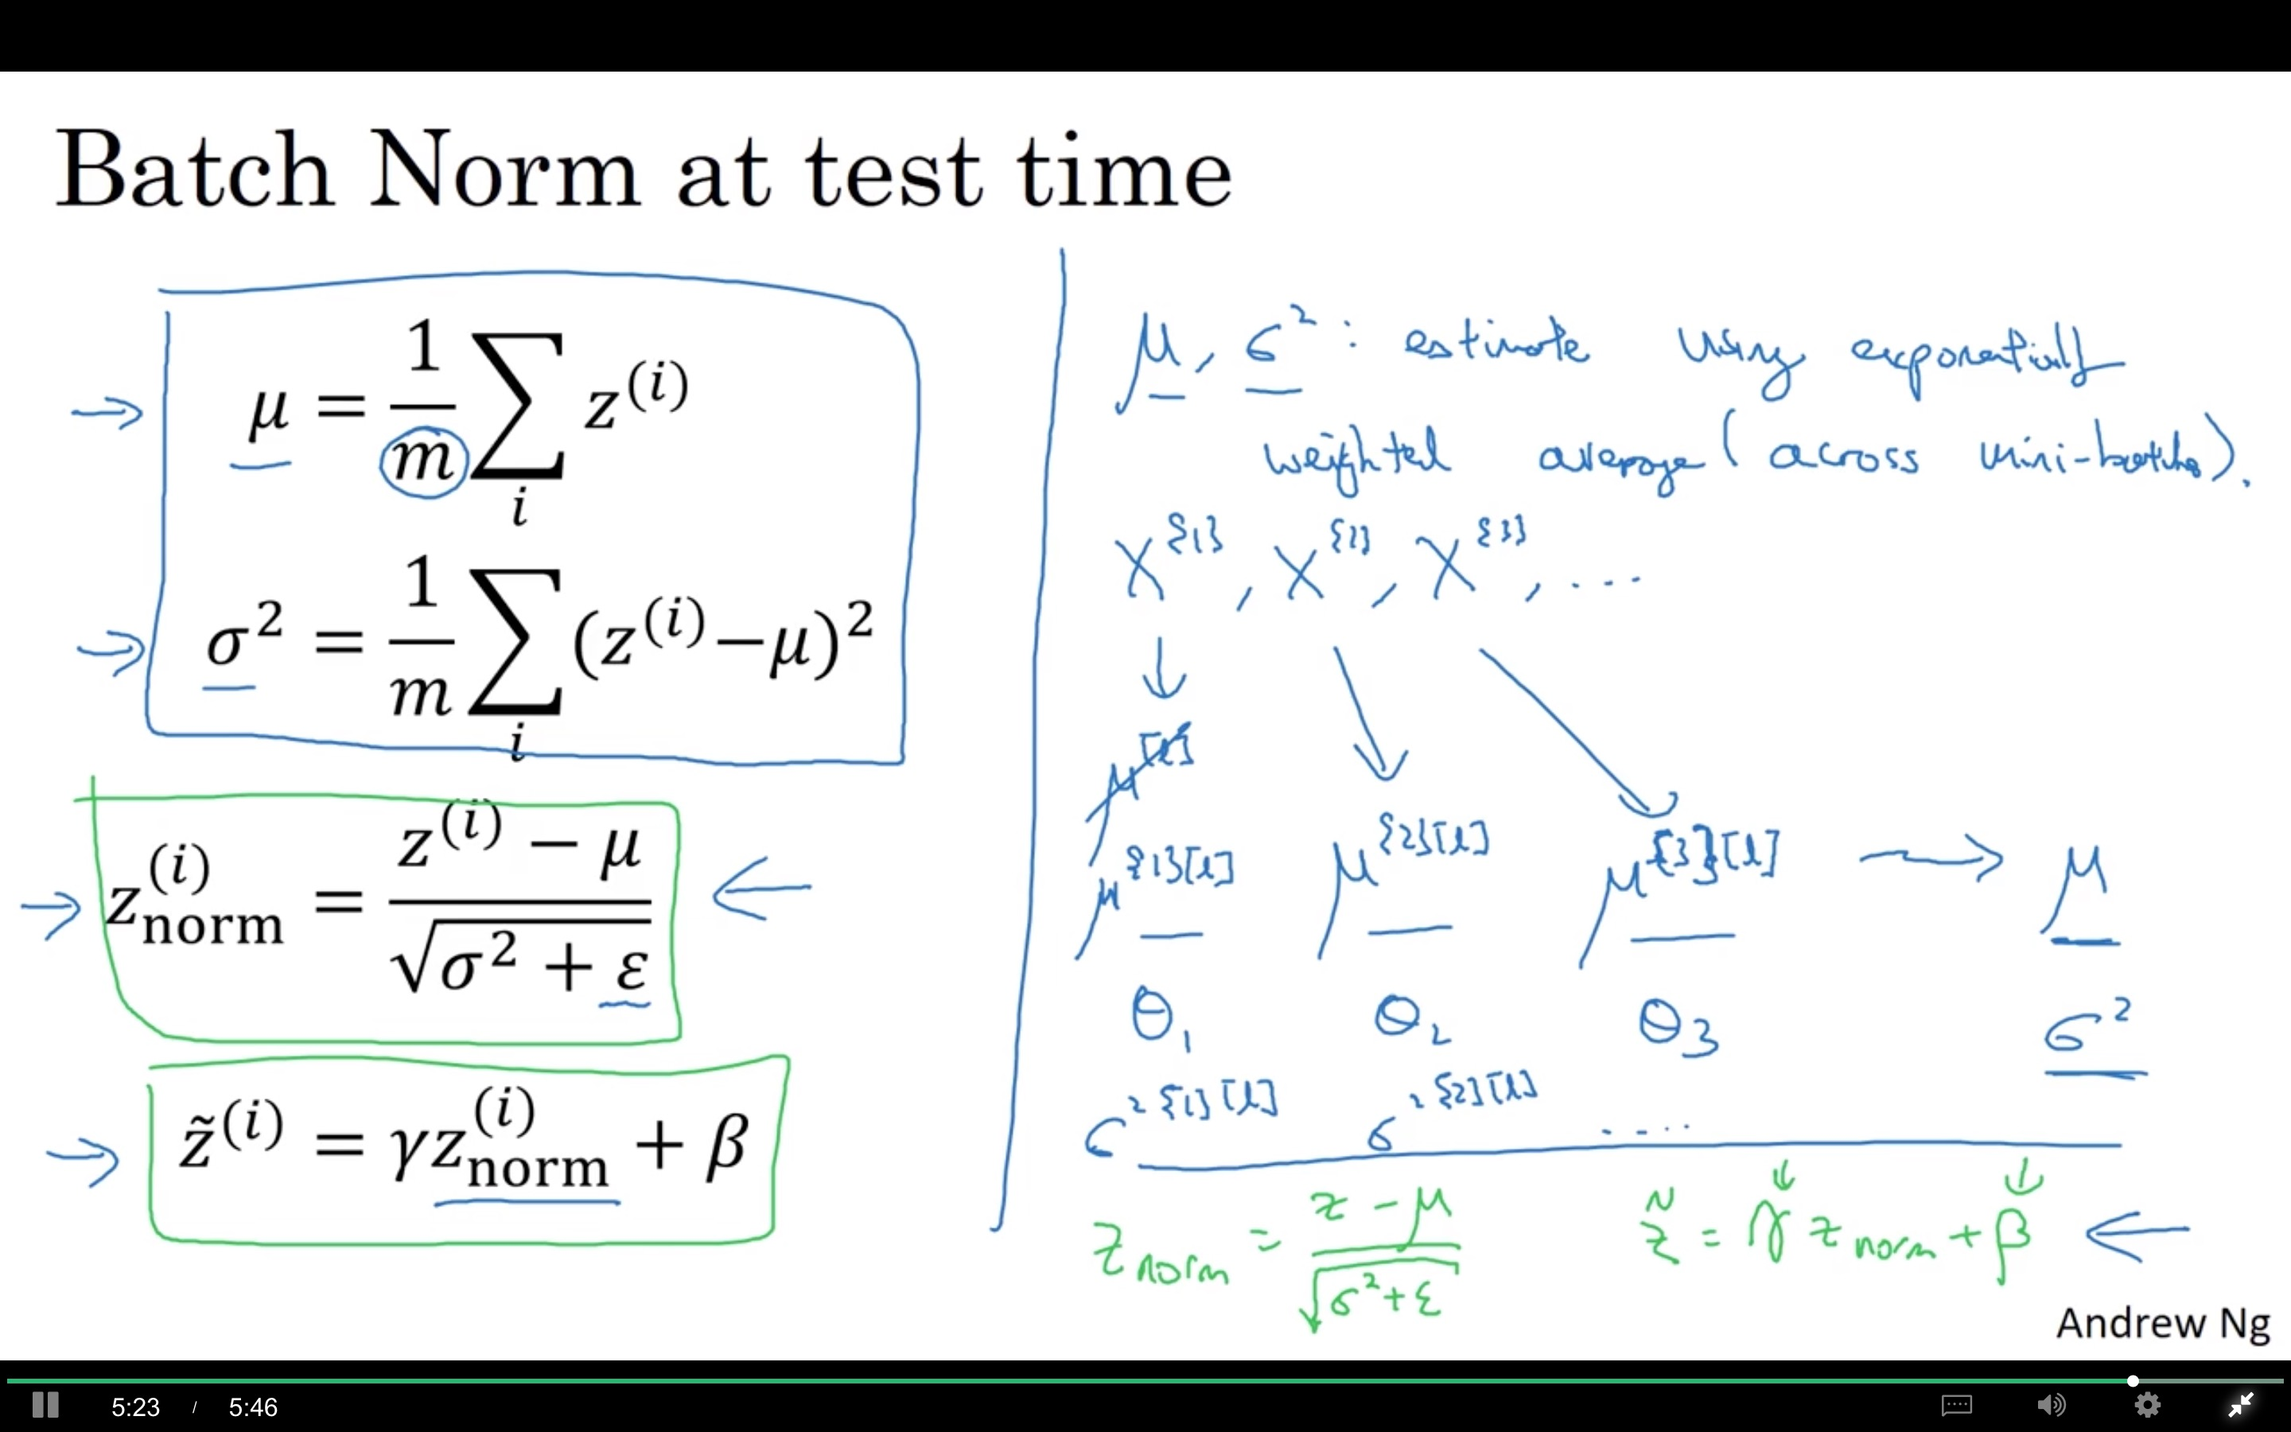

Slide 26
Multi-class classification
Softmax regression
deeplearning.ai

Slide 27
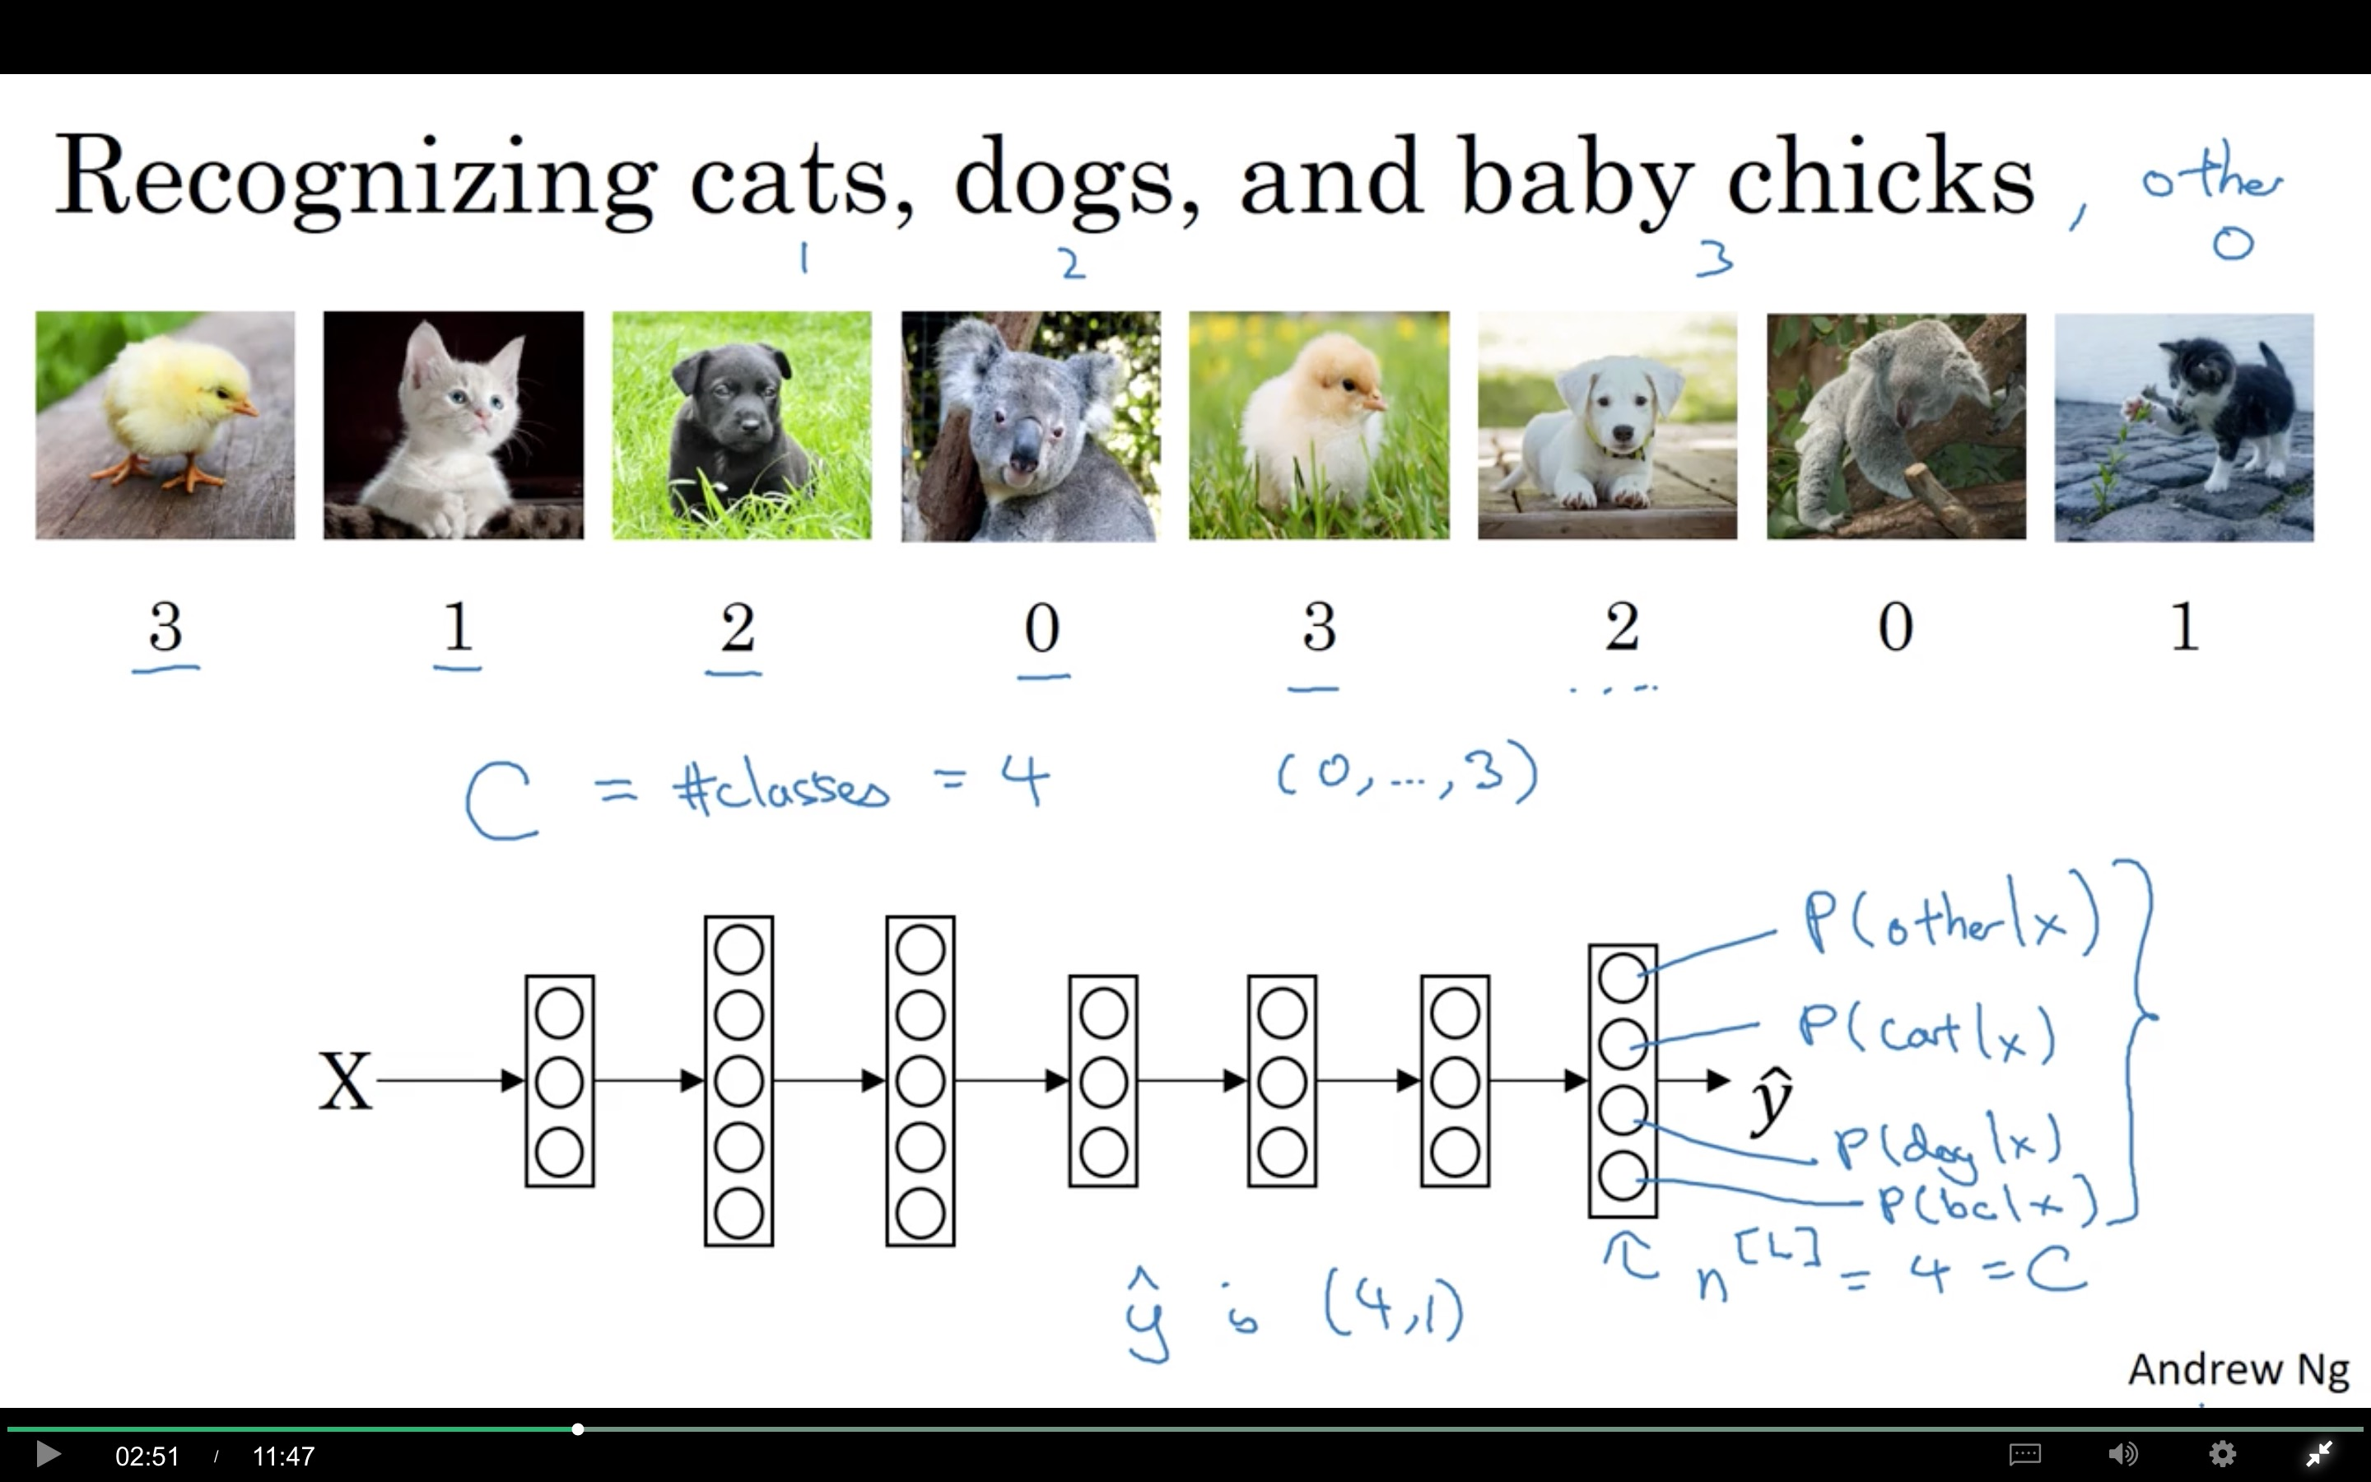

Slide 28
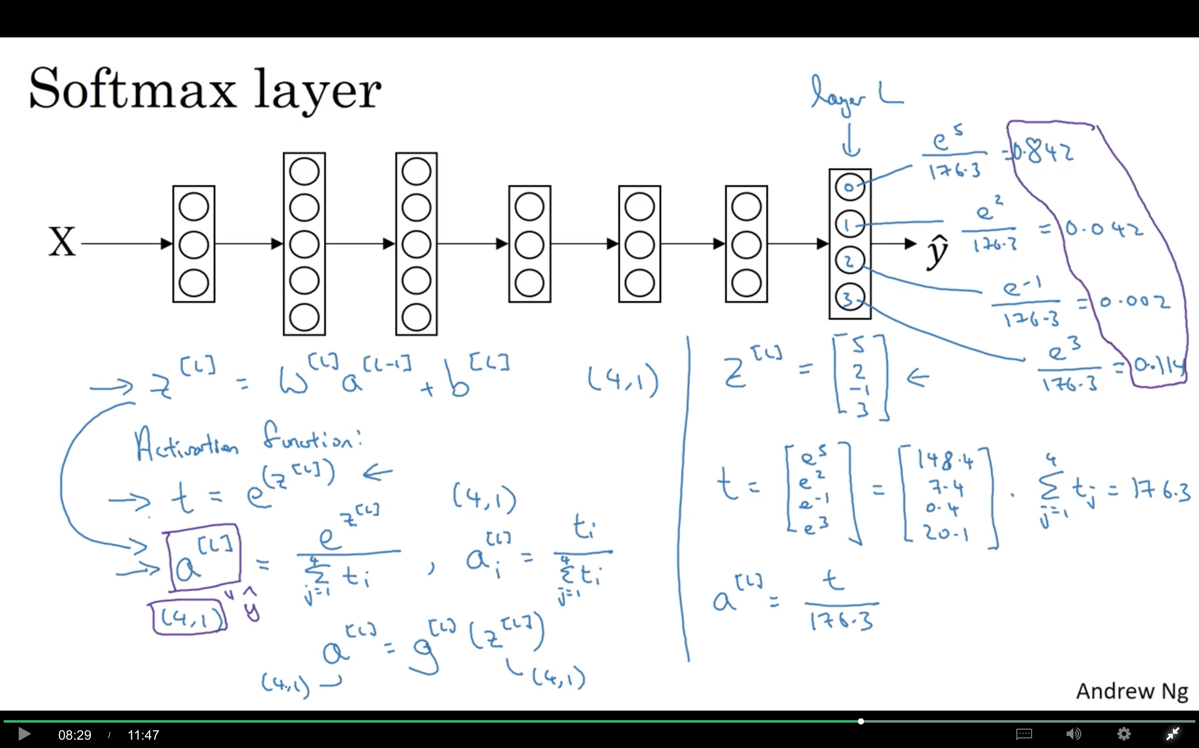

Slide 29
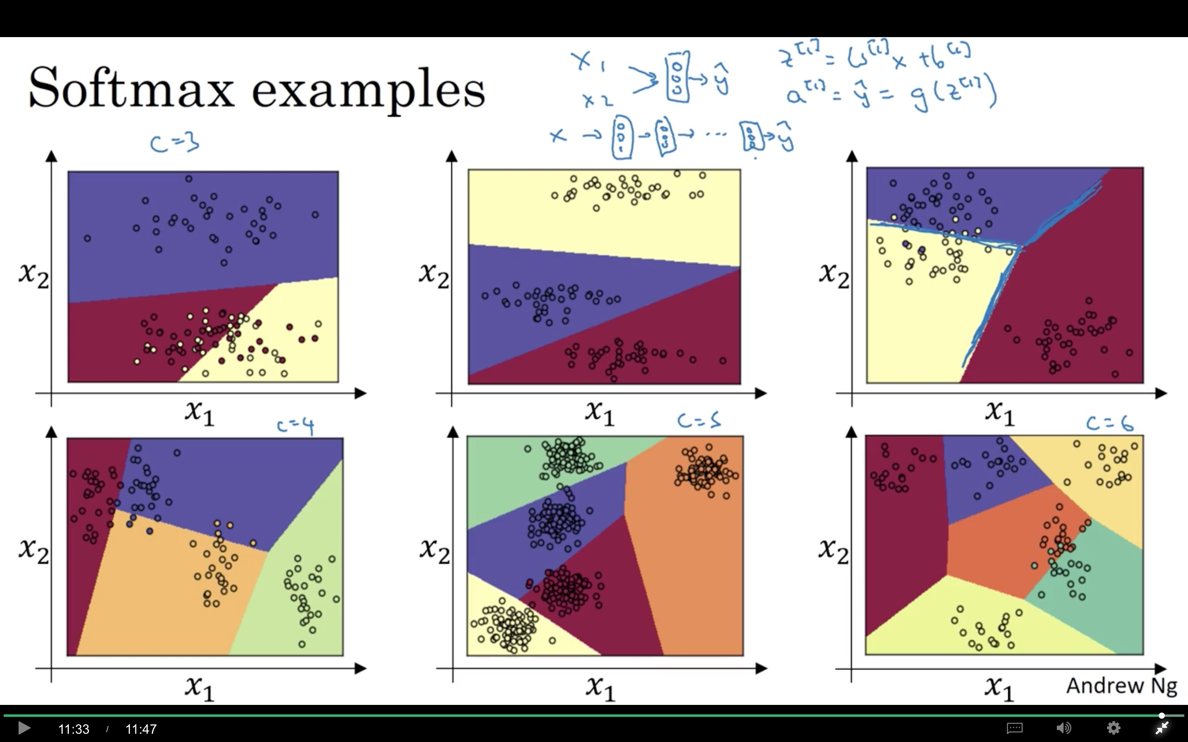
Linear boundary
More complex

Slide 30
Multi-class classification
Trying a softmax
classifier
deeplearning.ai

Slide 31
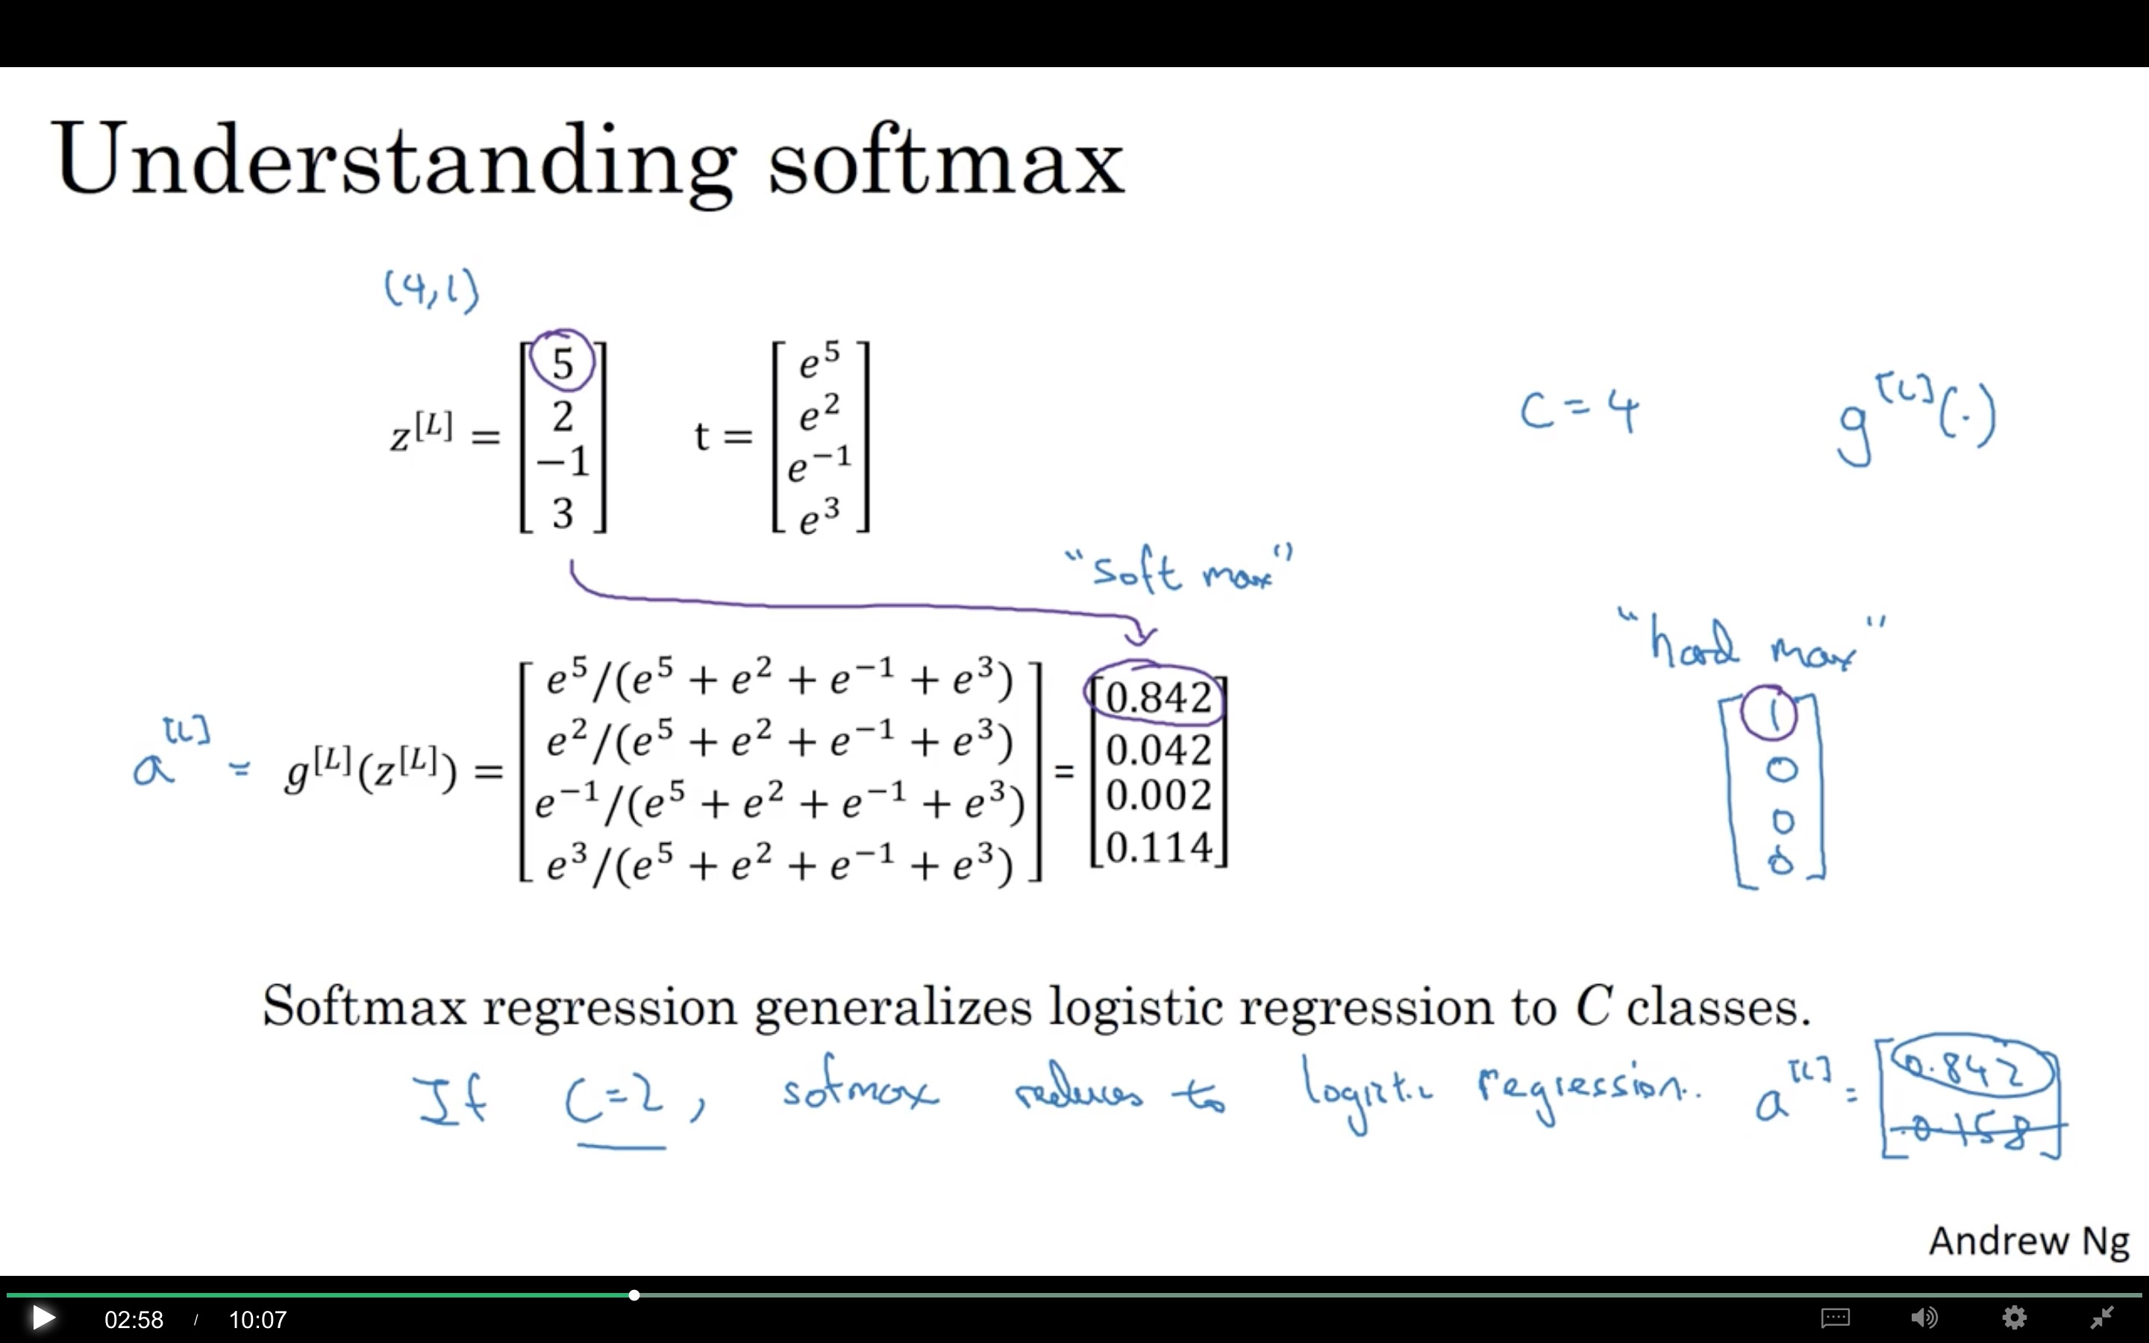

Slide 32
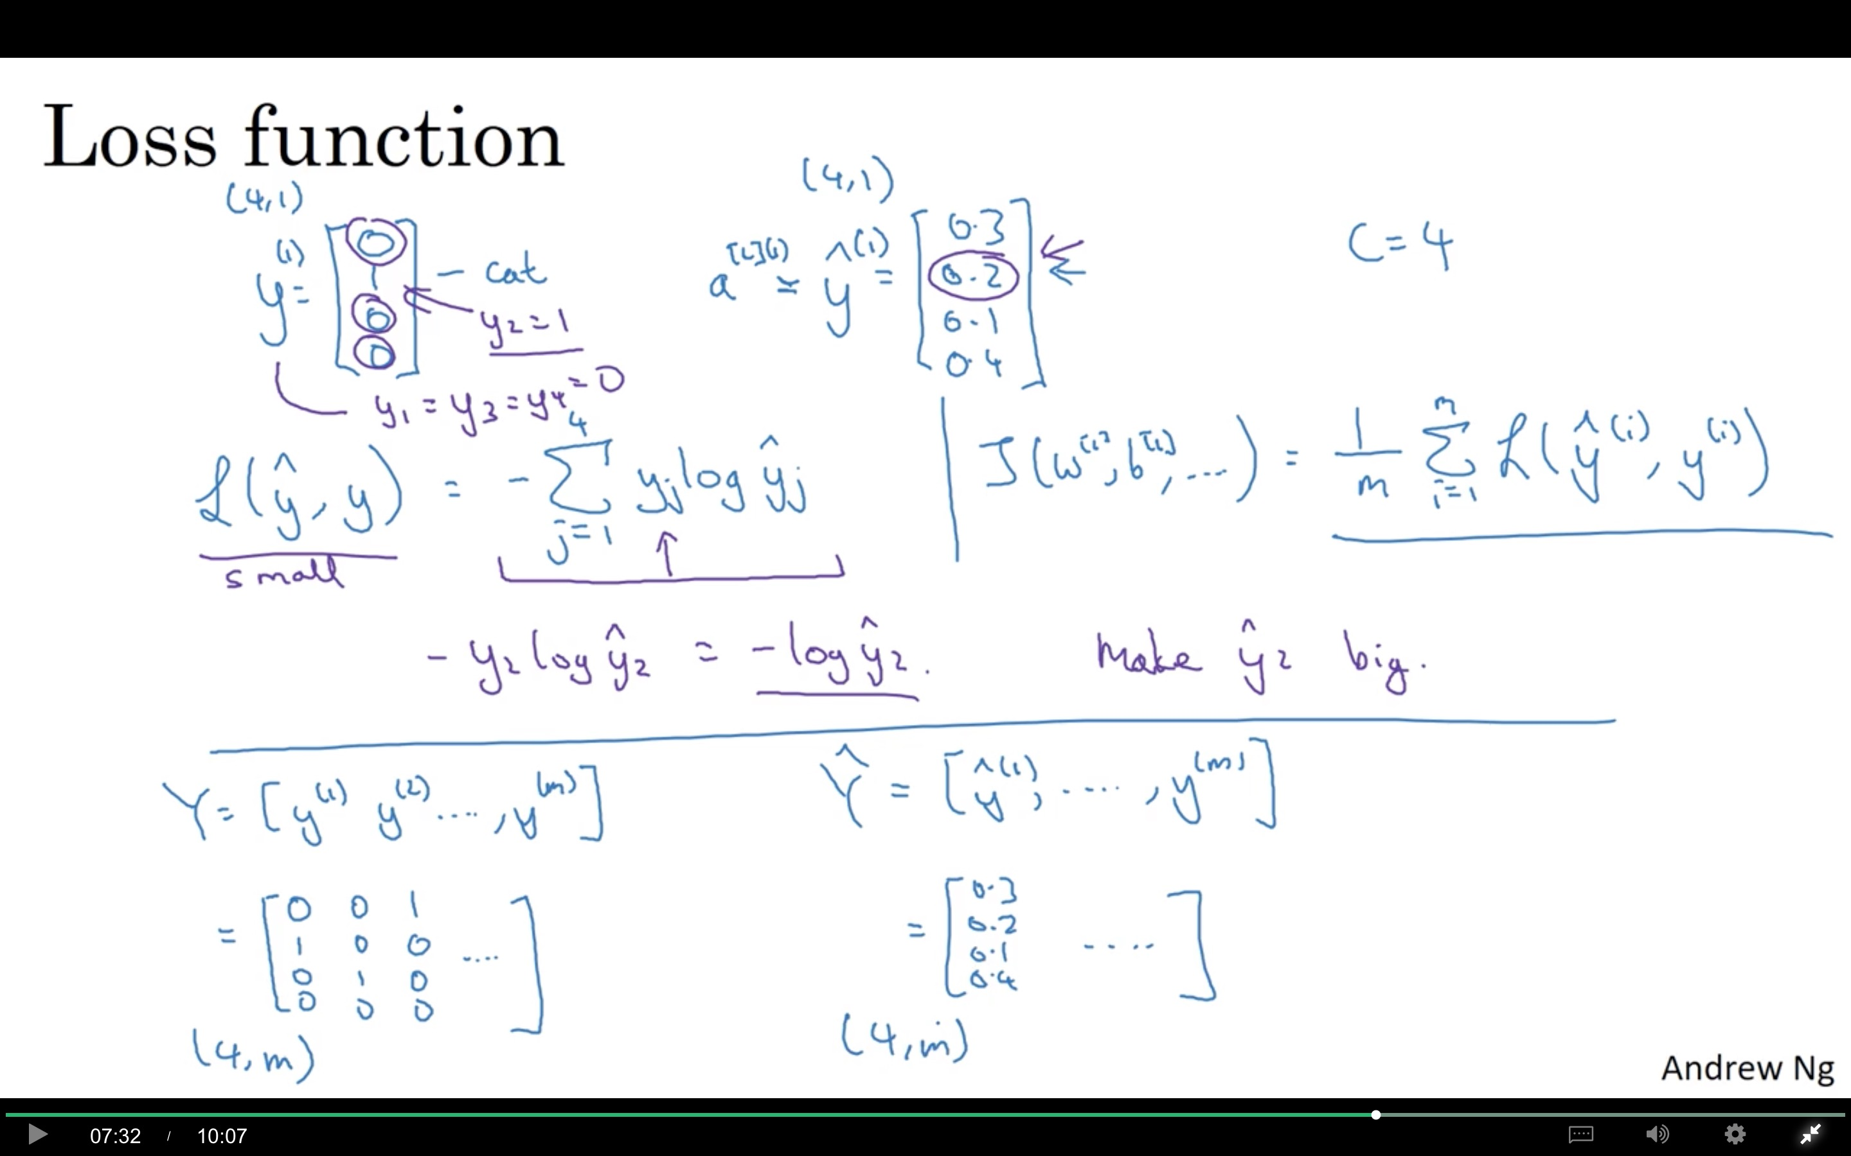

Slide 33
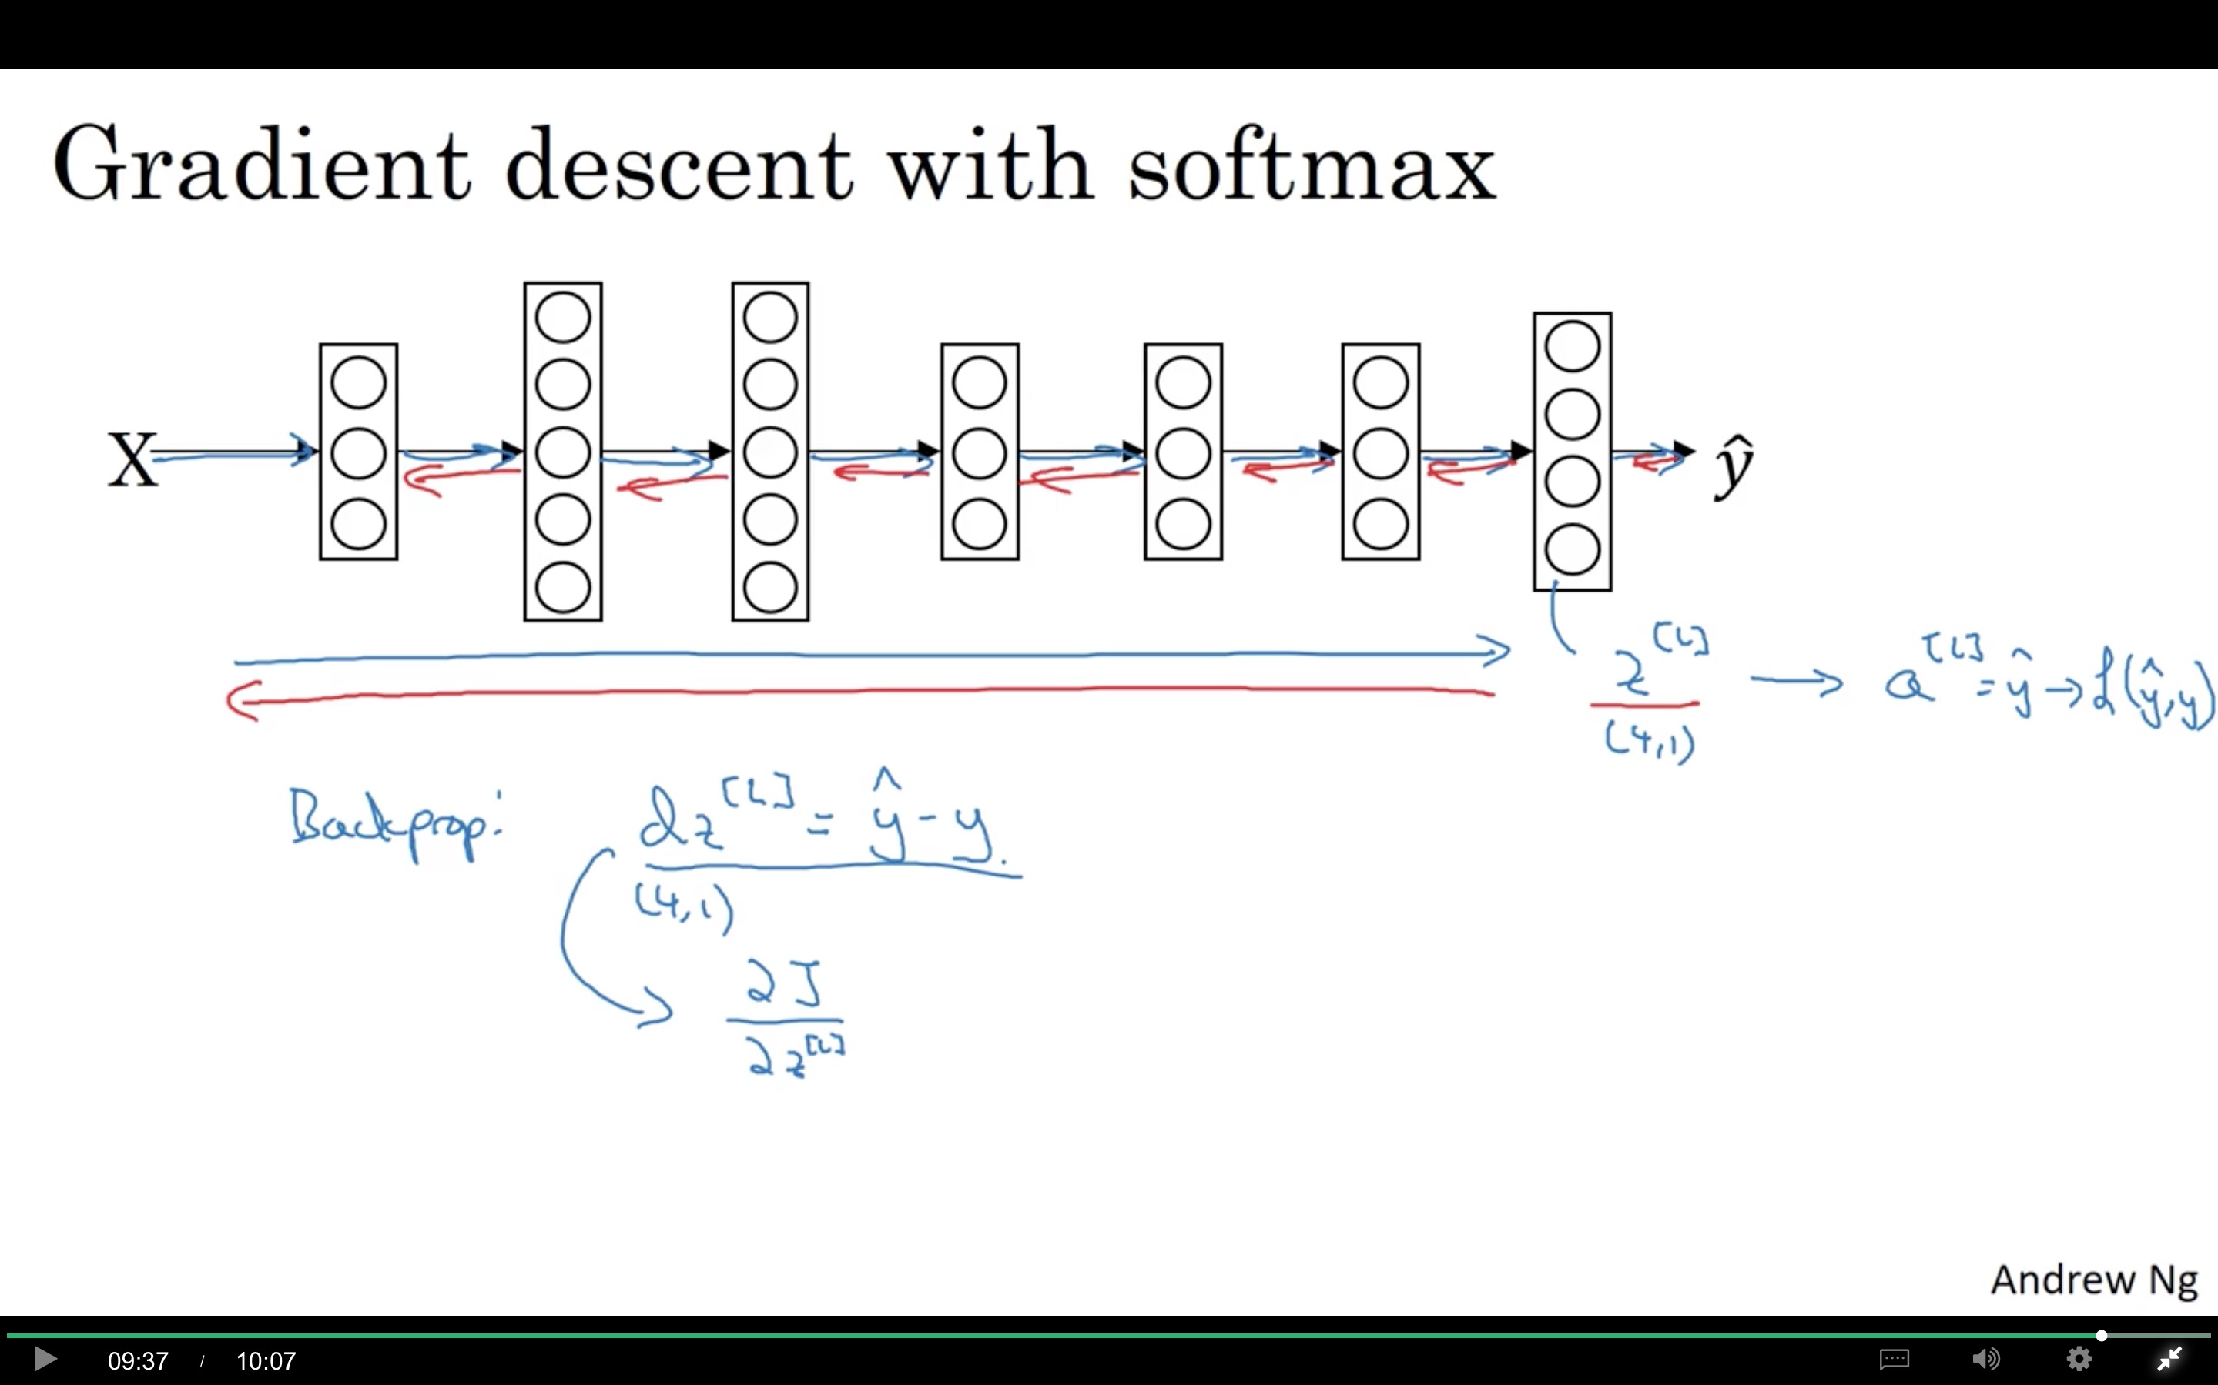

Slide 34
Programming Frameworks
Deep Learning frameworks
deeplearning.ai

Slide 35
Deep learning frameworks
Choosing deep learning frameworks
Ease of programming (development and deployment)
Running speed
Truly open (open source with good governance)
Caffe/Caffe2
CNTK
DL4J
Keras
Lasagne
mxnet
PaddlePaddle
TensorFlow
Theano
Torch

Slide 36
Programming Frameworks
TensorFlow
deeplearning.ai

Slide 37
Motivating problem

Slide 38
Code example
import numpy as np
import tensorflow as tf
coefficients = np.array([[1], [-20], [25]])
w = tf.Variable([0],dtype=tf.float32)
x = tf.placeholder(tf.float32, [3,1])
cost = x[0][0]*w**2 + x[1][0]*w + x[2][0] # (w-5)**2
train = tf.train.GradientDescentOptimizer(0.01).minimize(cost)
init = tf.global_variables_initializer()
session = tf.Session()
session.run(init)
print(session.run(w))
for i in range(1000):
session.run(train, feed_dict={x:coefficients})
print(session.run(w))
with tf.Session() as session:
session.run(init)
print(session.run(w))

